Slide 2
The Challenge
Client has proprietary survey in use for 20+ years.
Is it possible to shorten survey and impute the skipped questions?
Reduce burden on survey taker
Leverage past data to inform imputations
Multiple imputation – better than single imputation, but requires extra steps
Can we build software to automate the task so that office staff do not have to be programmers or statisticians?

Slide 3
Review of Multiple Imputation
X₁ | X₂ | X₃
3 | . | 7
4 | 3 | 8
6 | . | 3
X₁ | X₂ | X₃
3 | 5 | 7
4 | 3 | 8
6 | 7 | 3
X₁ | X₂ | X₃
3 | 2 | 7
4 | 3 | 8
6 | 5 | 3
X₁ | X₂ | X₃
3 | 4 | 7
4 | 3 | 8
6 | 6 | 3

Slide 4
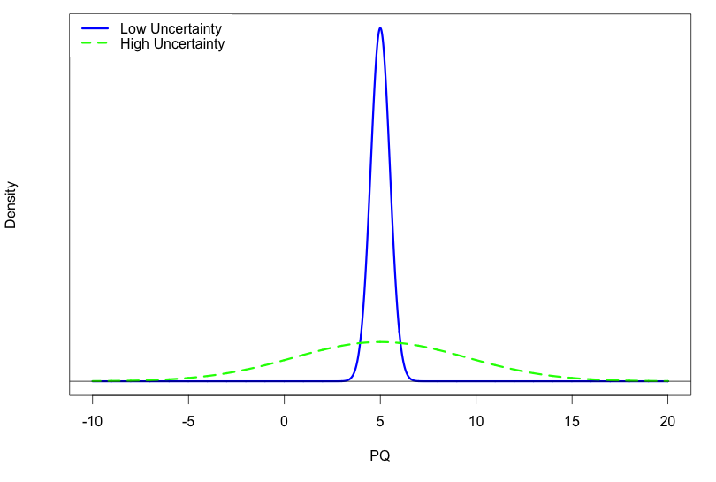
Multiple imputation
Do multiple times to capture the uncertainty.
Where uncertainty is high, imputed values will vary highly across repeated imputations.
Where uncertainty is low, imputed values will be closer to each other.
But with multiple data sets, how do I analyze?

Slide 5
Review of Multiple Imputation
X₁ | X₂ | X₃
3 | 5 | 7
4 | 3 | 8
6 | 7 | 3
Point estimates are the average estimate across imputations.
Standard errors combined to account for between imputation variance.
More uncertainty in imputations
more between imputation variability
larger SEs
→ larger p-values.
X₁ | X₂ | X₃
3 | . | 7
4 | 3 | 8
6 | . | 3
X₁ | X₂ | X₃
3 | 2 | 7
4 | 3 | 8
6 | 5 | 3
X₁ | X₂ | X₃
3 | 4 | 7
4 | 3 | 8
6 | 6 | 3

Slide 6

The Challenge
Statistical choices that have to be made when performing MI:
How much prior information should influence imputations?
How long to run Gibbs sampler to guarantee convergence?
How many multiply imputed files to create?
Practical issues to deal with:
Normal people do not think in terms of the marginals of a multivariate distribution, so how can a naïf specify a prior?
“What’s a Gibbs sampler?”
“This is why I hate statistics…”

Slide 7

The Solution
The good news: R can do anything.
Solve Sudoku puzzles.
Predict the probability of wife’s pregnancy.
Classify thousands of unread documents.
Read in missing and complete data, draw on complete data to formulate a prior over the missing data points in the missing file, conduct multiple imputation via chained equations with upper limits set on iterations, carry out the desired statistical analysis separately on each of the data sets, appropriately combine the results to make valid inferences, report the results in a familiar table as though the analysis had been performed on a full data set.
Keep you warm at night.
The bad news:
R is hard.
How can I deliver an R-based solution to non-programmers?

Slide 8


The Solution
R is hard.
Browsers are easy.
I write the R code on the backend that completes an arbitrarily difficult analytics task.
But the user never sees the code. Instead, the user interacts with an intuitive browser interface.
This is the raison d'être of Rshiny.

Slide 9
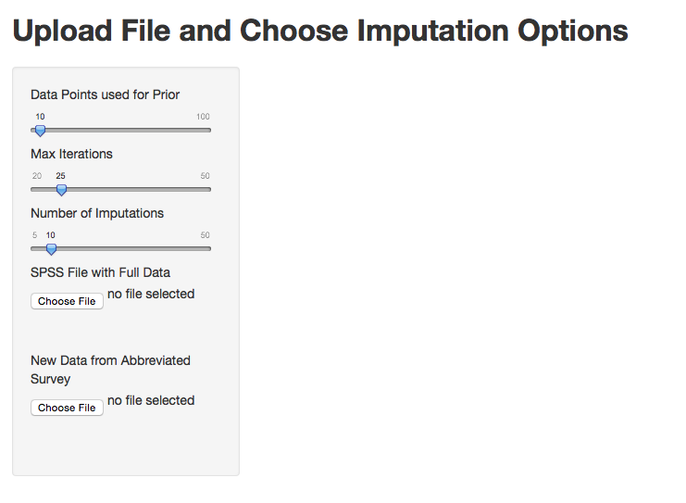
An RShiny Application
Program written in R with RShiny Web interface.
Easily set parameters:
Size of prior in terms of amount of data, not shape of marginal
Quickly, easily see effects of altering number of iterations and number of imputations.
Easily upload data file for prior and data file with missing.
Prior specified as number of data points from previous survey.
Easily experiment with number of iterations (default is 25).
Easily experiment with number of imputations (default is 10).
Select file with data points to use a prior (program randomly selects).
Select file that needs to be imputed.

Slide 10
An RShiny Application
All RShiny apps are based on two scripts:
server.R: R analysis code
ui.R: Set up browser interface.
The server.R script can be as lengthy and complicated as the analysis calls for.

Slide 11
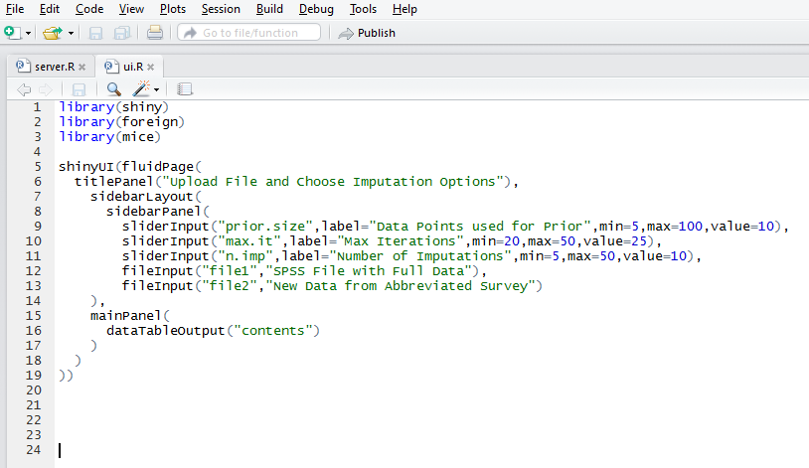
An RShiny Application
The ui.R script:
Adds a title.
Adds a slider to specify prior size.
Adds a slider to set maximum iterations.
Adds a slider to set number of imputations.
Adds two file input buttons for the full and missing data sets.
Tells the browser to display the regression results after it has run.

Slide 12
A Second Example
Working with hedge fund, we developed a neural network-based predictive model for stock performance.
On the basis of 44 proprietary predictors, we fit the model on historical data up to six months.
Once model is fit, simply add in today’s values of the predictors for each stock to get a probability of upwards or downwards movement.
Problem:
Client only knows Excel. Setting up model in Excel is tedious and error-prone.
Lots of stocks. Can we automate?

Slide 13
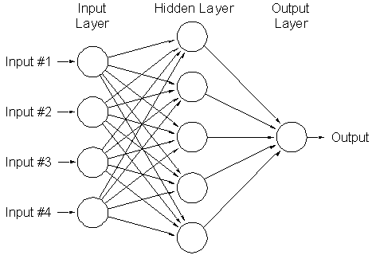
A Second Example
Neural networks:
Highly nonlinear, everything interacts with everything else.
Output is a function (usually logistic cdf) of the hidden layers.
Each hidden layer is a function (usually logistic cdfs) of the observed inputs.
Essentially a bunch of logistic regressions whose results become predictors in a subsequent logistic regression.
Lots of logistic regressions means lots of coefficients!!!!

Slide 14
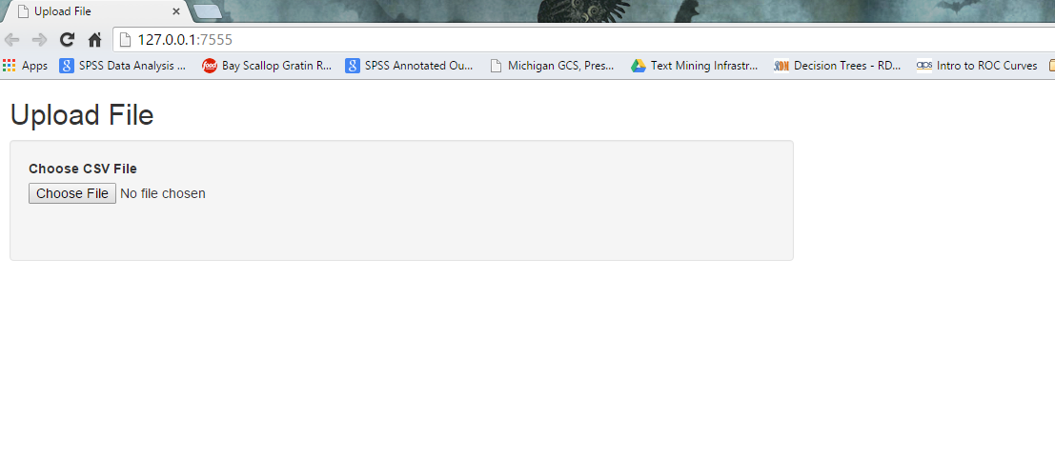
Shiny Implementation
Upload file with today’s values for all stocks.

Slide 15
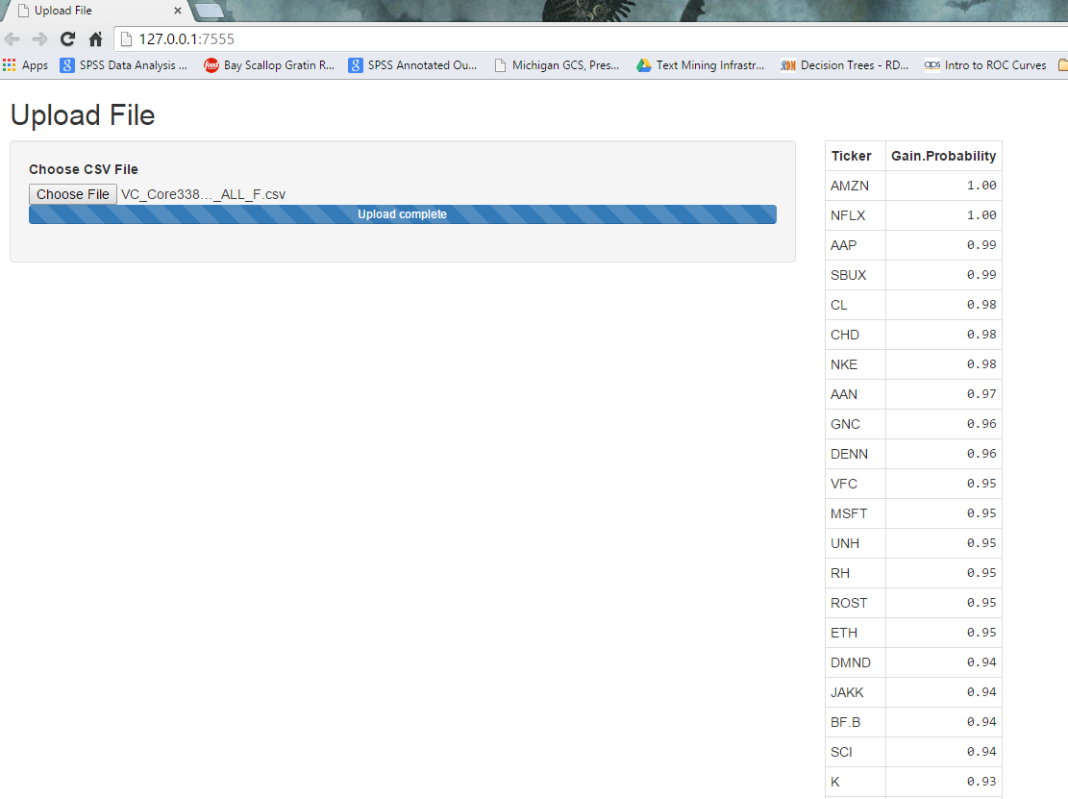
Shiny Implementation
Browser returns table with predictions for each symbol.

Slide 16
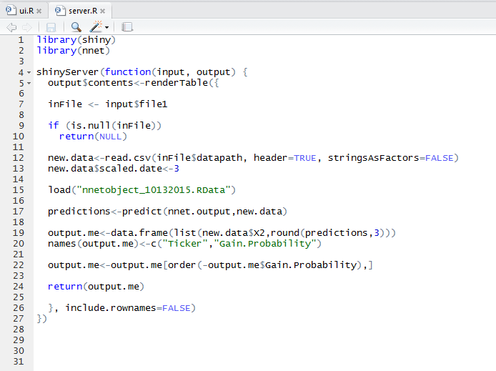
Shiny Implementation
Neural network saved at .RData file. Simply load…
… and use the prediction method to get values.

Slide 17
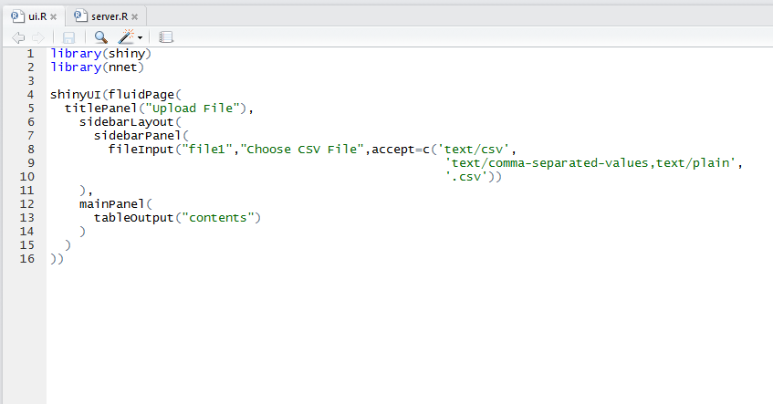
Shiny Implementation
ui.R file is minimal.

Slide 18
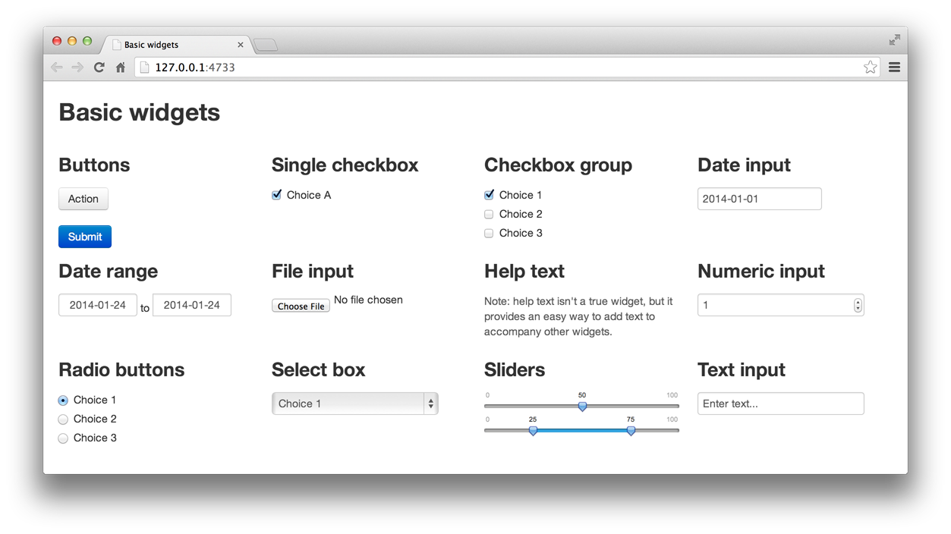
Extensions to RShiny
Lots of input options to keep things simple for user.
Can also incorporate:
HTML
CSS
Javascript

Slide 19

Resources to Learn RShiny
Online documentation is unusually excellent.
http://shiny.rstudio.com/

Slide 20
Sharing RShiny App
Requires installation of RShiny Server.
Check out https://www.shinyapps.io for one hosting option.
Easy to install on an EC2 instance in AWS.
Upload app to virtual machine.
Get URL to provide to client.
Can limit access to app.
Can customize URL for client.
http://www.r-bloggers.com/hosting-shiny-on-amazon-ec2/

